Slide 1
Machine Learning and Deep Learning for Forecasting
DSO 522 · APPLIED TIME SERIES FORECASTING
Popular models explained by intuition, applied in Python to a real day-ahead electricity forecasting problem
USC Marshall School of Business
Notes:
Today is an applied session. Every model gets one plain-language idea, one analogy, and then code you can run. We use one dataset throughout: hourly electricity load with temperature, the same kind of problem as the team competition.

Slide 2
Learning objectives and outcomes
Objectives: what this session teaches
Reframe forecasting as supervised learning: predict each hour from what was known before it.
Engineer calendar, lag, rolling-window and weather features without leaking the future.
Explain, without heavy math, how tree ensembles, neural networks and pretrained foundation models learn patterns.
Use the key Python functions of LightGBM, scikit-learn and the Nixtla libraries (statsforecast, mlforecast, neuralforecast).
Evaluate models honestly with time-based cross-validation against a naive baseline.
Outcomes: what you can do afterward
Build a leakage-free feature table from an hourly series in pandas.
Train and tune LightGBM and random forest forecasters, and read their feature importance.
Run N-HiTS and Chronos in a few lines of code and know when they pay off.
Produce a comparison of MAE, RMSE, MAPE and run time across models.
Translate a forecast-accuracy gain into dollars and defend which model to deploy.
DSO 522 · ML and Deep Learning for Forecasting
Notes:
Read the outcomes aloud: by the end of class each student should be able to do all five with the notebook. The notebook ML_DL_Forecasting_in_Python.ipynb follows the same order as these slides.

Slide 3
Today’s roadmap
Minutes | Block | What you will do
0–10 | Why ML, and our case | See where ML beats classic models; meet the day-ahead load problem
10–25 | Forecasting as a table | Lags, forecast strategies, rolling-origin validation
25–50 | Feature engineering | Calendar, lags, rolling windows, weather, transformations, leakage
50–65 | Tree ensembles | Random forest and LightGBM; tuning; mlforecast
65–70 | Break
70–85 | Deep learning | LSTM, N-HiTS, Temporal Fusion Transformer; neuralforecast
85–95 | Foundation models | Chronos and TimesFM: forecasting with no training
95–110 | Bake-off and decisions | Compare all models, translate accuracy into dollars, choose one
Rhythm for every model: intuition first (5 minutes), then the Python functions, then run the notebook cell.
DSO 522 · ML and Deep Learning for Forecasting
Notes:
Times assume a 110-minute session. If time runs short, compress the deep learning block to N-HiTS only and keep the bake-off: the comparison is where the business learning happens.

Slide 4
Why machine learning for forecasting now
What changed in the last decade
M4 competition (2018): the winner was a hybrid of exponential smoothing and a neural network, the first time ML beat pure statistics at scale.
M5 competition (2020, Walmart sales): top solutions were built on LightGBM with heavy feature engineering.
2023–2025: pretrained “foundation” models (Chronos, TimesFM, Moirai, TimeGPT) forecast series they have never seen.
Cheap computing and free libraries made all of this a few lines of Python.
Where ML wins, and where it does not
Wins: many related series (products, stores, sensors), lots of history, and outside drivers such as weather, price or promotions.
Wins: nonlinear effects, like load rising in both cold and hot weather.
Often loses: short series, a few dozen monthly points, or when the past pattern is simple and stable. ETS and ARIMA stay hard to beat there.
Practitioner rule: ML is a tool, not a religion. Always keep a simple baseline in the comparison.
DSO 522 · ML and Deep Learning for Forecasting
Notes:
The M competitions (Makridakis competitions) are the Olympics of forecasting. The key message: ML did not replace statistical forecasting; it won where there is a lot of data and outside information. Our electricity case is exactly that situation, which is why ML will do well today.

Slide 5
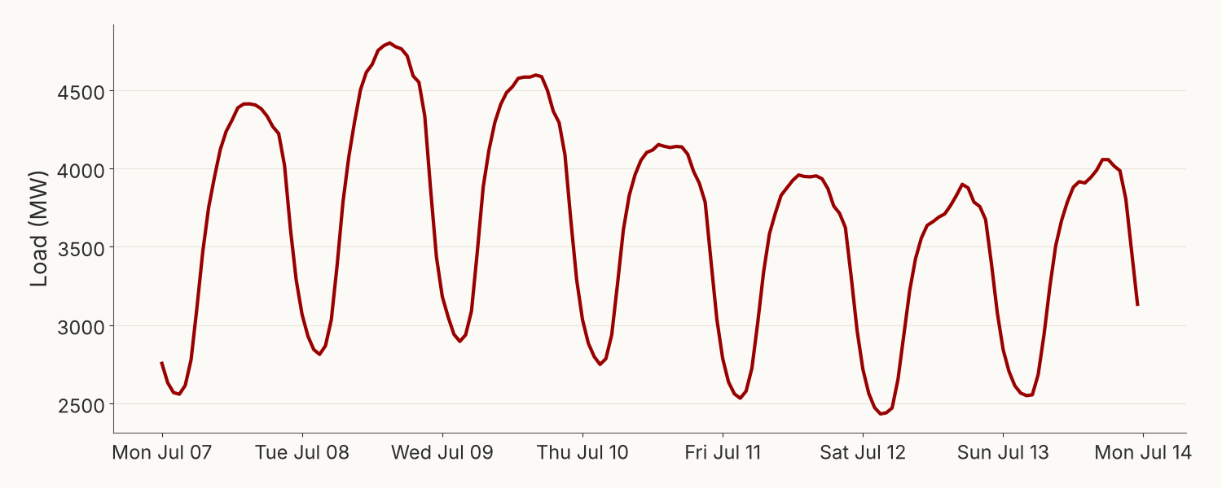
The case: forecasting tomorrow’s electricity load
Business problem. Every day a utility commits power plants for each of tomorrow’s 24 hours. Under-forecast and it buys expensive last-minute power; over-forecast and it pays for generation nobody uses.
Data (energy.csv, course repo)
26,304 hourly observations, Jan 2012 – Dec 2014, no gaps
Load in megawatts (MW): typical 3,300 MW, peak 5,224 MW
Hourly temperature (°F) for the same area
Our task. At midnight, forecast all 24 hours of the next day. We test on the last 14 days of 2014.
One summer week (July 7–13, 2014): a daily cycle peaking in late afternoon, with lower demand on the weekend. Two seasonal cycles at once: 24 hours and 168 hours.
DSO 522 · ML and Deep Learning for Forecasting
Notes:
This is the same type of problem as the team competition, but a different utility and period, so nothing here hands you a competition answer. Point out the two cycles: daily (24 hours) and weekly (168 hours). They are why the lags 24 and 168 will matter so much.

Slide 6
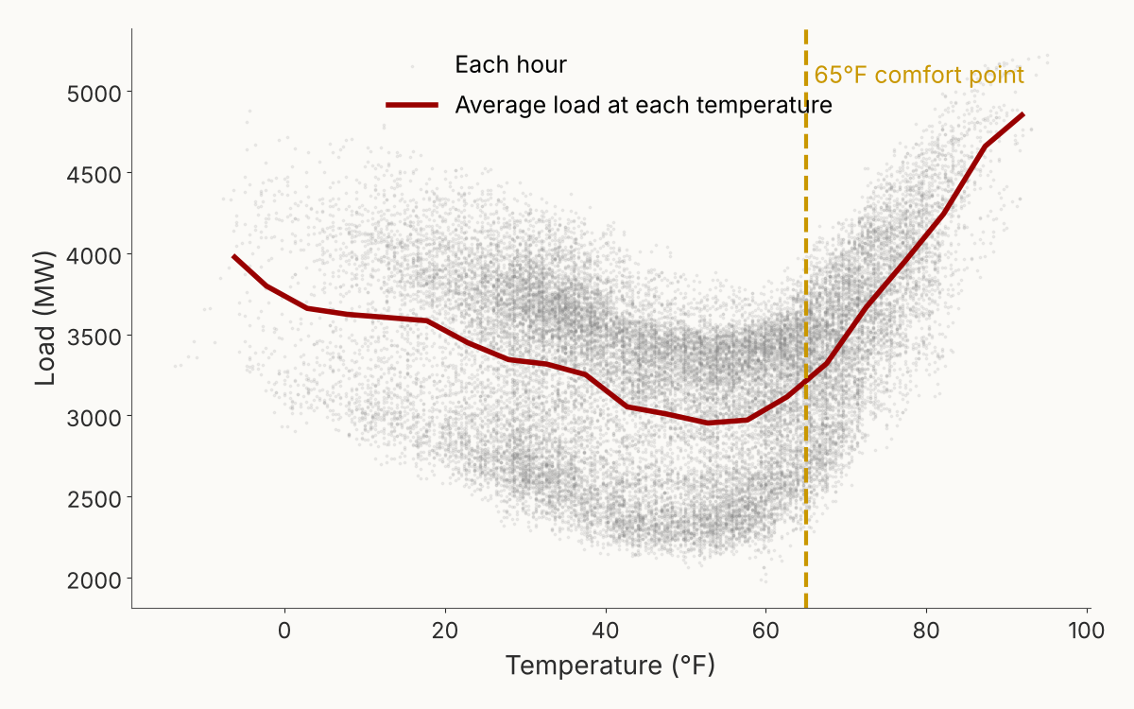
Temperature matters, but not in a straight line
The correlation between load and temperature is only 0.07. A naive analyst would drop temperature. That would be a costly mistake.
Below about 65°F, colder weather means more heating load.
Above 65°F, hotter weather means more air-conditioning load.
Correlation measures only straight-line relationships, so the two sides cancel out.
Two ways to capture a U-shape: engineer it (heating and cooling degrees, coming up), or use a model that learns curves by itself (trees and neural networks).
DSO 522 · ML and Deep Learning for Forecasting
Notes:
Ask the class first: correlation 0.07, should we drop temperature? Then show the curve. Later, removing the weather features from LightGBM doubles the error, from 66 to 132 MW. This is the most important feature-engineering lesson of the day.

Slide 7
The big idea: turn the series into a table
FORECASTING AS SUPERVISED LEARNING
A machine learning model knows nothing about time. It learns a mapping from columns to a target. So we build a table where each row is one hour, the target is that hour’s load, and every column is something we knew before that hour.
Hour (ds) | hour | dayofweek | temp °F | lag24 | lag168 | roll_mean_24 | y (target)
Jul 8, 15:00 | 15 | 1 (Tue) | 85.3 | 4,413 | 4,806 | 3,519 | 4,802
Jul 8, 16:00 | 16 | 1 (Tue) | 84.7 | 4,406 | 4,812 | 3,550 | 4,778
Jul 8, 17:00 | 17 | 1 (Tue) | 82.0 | 4,382 | 4,804 | 3,577 | 4,764
Real rows from our data (2014). lag24 = load at the same hour yesterday; lag168 = same hour last week; roll_mean_24 = average load over the last known day. Once the data look like this, any regression model can forecast: LightGBM, random forest, even linear regression.
Practitioner tip: in most real projects the features, not the algorithm, decide accuracy. Spend 70% of your time here.
DSO 522 · ML and Deep Learning for Forecasting
Notes:
This slide is the bridge from everything in the course so far. Regression with dummies, which they know, is already this idea: calendar columns plus a target. ML adds lags and rolling windows and swaps the linear model for a flexible one. Note that lag168 is very close to the actual on this Tuesday, while lag24 (Monday) is lower: the weekly lag captures the weekday pattern.

Slide 8
Lag features and the availability rule
What a lag is. A lag of k hours is the value of the series k hours earlier. In pandas: df["y"].shift(k). It answers: “what happened at a comparable moment in the past?”
The availability rule for day-ahead forecasting
We forecast at midnight for all 24 hours of tomorrow. The last load we have is today at 23:00.
For tomorrow at 23:00, a 1-hour lag would be tomorrow at 22:00, which we do not know yet.
So one model for all 24 hours can use only lags of 24 hours or more: 24, 48, 168.
Practitioner tip: real utilities often forecast at 10:00 for the next day, so the shortest usable lag is about 38 hours. Always write down the forecast origin before building a single feature.
Why lags work. Load repeats every day and every week. The same hour yesterday and the same hour last week are the best single guides to this hour.
The forecast origin. The moment you make the forecast. Every feature must be known at that moment, for every hour you forecast.
DSO 522 · ML and Deep Learning for Forecasting
Notes:
This is the most common mistake students make in the competition: using lag 1. A lag-1 model looks fantastic in a backtest because it always knows the previous hour, but it cannot be used for a day-ahead forecast. Draw a timeline on the board: today 00:00 to 23:00 known, tomorrow 00:00 to 23:00 to forecast.

Slide 9
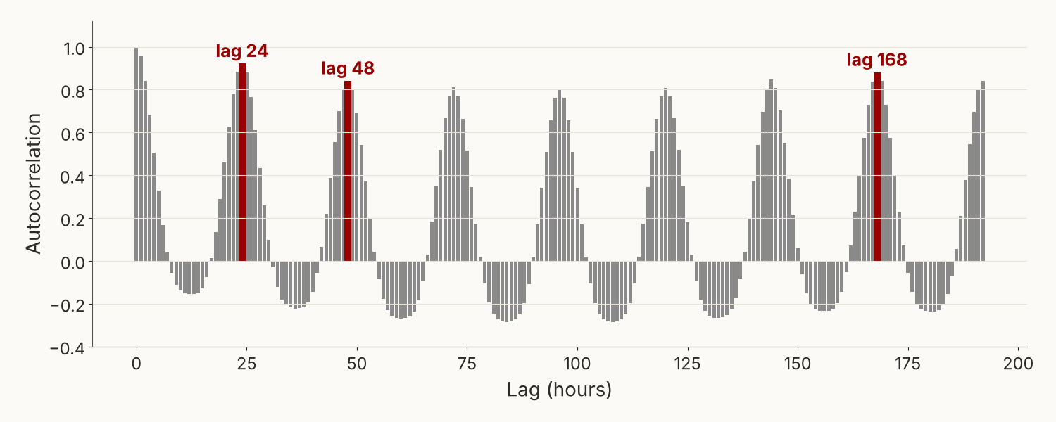
Choosing which lags to use
Three practical ways to pick lags
Seasonal periods: one and two cycles back (24, 48) and one week back (168).
The ACF plot: keep lags at the peaks; skip the valleys.
Feature importance: start generous, then drop lags the model never uses.
Tip: for daily data use 7, 14, 28 and 364 (same weekday last year); for monthly data use 1, 12.
Autocorrelation of hourly load: how similar the series is to itself k hours earlier. Peaks at 24, 48 and 168 hours.
DSO 522 · ML and Deep Learning for Forecasting
Notes:
Students know the ACF from the decomposition and ARIMA material. Here it has a new job: a shopping list for lag features. In the notebook, lag168 and lag24 together account for almost 88% of LightGBM's total gain.

Slide 10
Forecasting 24 hours ahead: three strategies
Strategy | How it works | Strengths | Weaknesses | Used by
Recursive | Train a one-step model; forecast hour 1, feed that forecast back in as a lag, forecast hour 2, and so on | One model; uses the most recent lags | Errors pile up over the horizon | mlforecast default, ARIMA
Direct | Train a separate model for each horizon: one for 1 hour ahead, one for 2 hours ahead … 24 models | No error accumulation | 24 models to train and maintain | mlforecast max_horizon=24
Multi-output | One model outputs all 24 values at once | One model; consistent daily shape | Needs a model that supports it | N-HiTS, N-BEATS, TFT
What we do today: use only lags of 24 hours or more. Then one ordinary model forecasts any hour of tomorrow from known values, with no feeding back. It behaves like the direct strategy at the cost of one model.
Tip: for horizons longer than the shortest lag, check how error grows with horizon. If it grows fast, switch from recursive to direct.
DSO 522 · ML and Deep Learning for Forecasting
Notes:
Recursive forecasting is what ARIMA does implicitly. For electricity, the "lags at least 24" trick is simple and robust. In mlforecast, recursive is the default; passing max_horizon=24 to fit trains the direct version.

Slide 11
Honest validation: rolling-origin cross-validation
Each row is one backtest; time runs left to right
Never shuffle time series. A random split lets the model learn from the future and grade itself on the past.
Rolling origin: forecast day 1, step forward, forecast day 2 … We use 14 windows of 24 hours (Dec 18–31, 2014) and average the errors.
Settings you choose
h = horizon (24); n_windows (14); step_size (24)
Refit every window (closest to production, slower) or train once (faster)
Tip: include hard periods (holidays, heat waves) in your windows, or the score will flatter you.
Tan = data the model may learn from. Red = the next 24 hours it must forecast. The origin moves forward one day each time.
DSO 522 · ML and Deep Learning for Forecasting
Notes:
Our 14 test days include Christmas and New Year's Eve: deliberately hard. In the Nixtla libraries this is one call: cross_validation(df, h=24, n_windows=14, step_size=24). statsforecast and mlforecast refit at every window by default; neuralforecast trains once and slides forward.

Slide 12
The seven feature families of a forecasting model
FEATURE ENGINEERING
Family | Examples | What it captures | Watch out for
Calendar | hour, day of week, month, day of year, weekend | Regular daily, weekly, yearly cycles | Cyclical encoding for linear models and neural nets
Events | holidays, day before or after, bridge days, special events | Days that break the routine | Rare: few examples to learn from
Lags | lag24, lag48, lag168 | What happened at comparable moments | Must be at least the horizon
Rolling windows | 24-hour mean and std, 7-day mean, EWMA | Recent level and volatility | Shift before rolling, always
Outside drivers | temperature, HDD/CDD, price, promotions | Why tomorrow differs from today | Their future values must be known
Interactions | hour × temperature, weekend × hour | Effects that depend on context | Trees learn many; add the key ones
Target transforms | log, differencing, scaling | Trend, changing variance | Back-transform the forecast
Our notebook builds 20 features from just two raw columns, load and temperature. The rest of this section takes each family in turn.
DSO 522 · ML and Deep Learning for Forecasting
Notes:
Use this as the map for the next ten slides. A practical rule from industry: one feature family usually carries most of the accuracy (here lags and weather), so build those carefully first, then add the rest and check whether they help on the validation windows.

Slide 13
Calendar and event features
Calendar features come free from the time stamp and are always known in advance.
hour (0–23): the daily shape
dayofweek (0 = Monday): weekdays versus weekends
month, dayofyear: the yearly heating and cooling seasons
weekend: a simple 0/1 flag
Event features mark days that break the routine:
Federal holidays, plus the day before and after
Bridge days: a Friday between Thanksgiving and the weekend
Local events: school breaks, big games, New Year’s Eve
Daylight-saving days: one 23-hour and one 25-hour day a year
X["hour"] = X["ds"].dt.hour
X["dayofweek"] = X["ds"].dt.dayofweek
X["month"] = X["ds"].dt.month
X["dayofyear"] = X["ds"].dt.dayofyear
X["weekend"] = (X["dayofweek"] >= 5).astype(int)
# holidays from pandas
from pandas.tseries.holiday import \
USFederalHolidayCalendar
hol = USFederalHolidayCalendar().holidays(
start=X["ds"].min(), end=X["ds"].max())
X["holiday"] = X["ds"].dt.normalize() \
.isin(hol).astype(int)
DSO 522 · ML and Deep Learning for Forecasting
Notes:
Practical tip: the federal calendar misses days that matter for load, such as the day after Thanksgiving and Christmas Eve. Experienced forecasters keep their own event table and update it every year. In our test window, New Year's Eve is not a federal holiday, so no model knows it is special: a good discussion point when looking at errors.

Slide 14
Cyclical encoding: hour 23 sits next to hour 0
The problem. Coded as a number, hour 23 and hour 0 look 23 units apart, but they are one hour apart. December and January have the same issue.
Which models need it?
Linear regression and neural networks: yes. They treat numbers as distances.
Trees (LightGBM, random forest): rarely. They split on thresholds such as hour ≥ 17, so the raw hour works fine. In our model the sine and cosine add only 0.8% of total gain.
Tip: Fourier terms. For long cycles, add several sine and cosine pairs (k = 1, 2, 3 …) of day of year. Three to five pairs capture a smooth yearly shape without 365 dummy variables.
The fix. Place the hour on a clock face and use its two coordinates:
hour_sin = sin(2π × hour / 24)
hour_cos = cos(2π × hour / 24)
Use the period that fits: 24 for hours, 7 for weekdays, 12 for months, 365.25 for day of year.
DSO 522 · ML and Deep Learning for Forecasting
Notes:
Draw a clock on the board. Hour 0 is at the top, hour 6 at the right, and so on. The sine and cosine are the x and y coordinates of the hand. Students who know dummy variables can compare: 24 hour dummies versus two smooth columns. Fourier terms are the same idea extended to more harmonics.

Slide 15
Rolling-window features: shift first, then roll
What they add. A lag is one past value; a rolling feature summarizes a whole recent window, which is less noisy.
Mean over the last day or week: the current level
Standard deviation: how volatile demand has been
Min and max: the recent range, useful for peaks
Exponentially weighted mean (EWMA): recent hours count more
The golden rule. The window must end before the forecast origin. Shift by the horizon (24) first, then roll. A window that includes the current hour leaks the answer.
Tip: pick windows that match the cycles (24, 168) so each window covers whole days or weeks.
# right: shift 24, then roll
past = X["y"].shift(24)
X["roll_mean_24"] = past.rolling(24).mean()
X["roll_std_24"] = past.rolling(24).std()
X["roll_max_24"] = past.rolling(24).max()
X["roll_mean_168"] = past.rolling(168).mean()
X["ewm_24"] = past.ewm(span=24).mean()
# WRONG: includes the hour we forecast
X["leak"] = X["y"].rolling(24).mean()
DSO 522 · ML and Deep Learning for Forecasting
Notes:
The wrong line is one of the most common bugs in real forecasting code. In the notebook we deliberately add a leaked rolling feature: the error falls to 0.67% MAPE, three times better than the honest model. Too good to be true always deserves suspicion.

Slide 16
Weather features: turning temperature into demand
Heating and cooling degrees straighten the U-shape:
HDD = max(0, 65 − temp) CDD = max(0, temp − 65)
Practitioner tips
Forecast versus actual. In production you only have tomorrow’s weather forecast. Training on actual temperatures makes backtests look better than reality. If you can, train on the forecasts you will really have.
65°F is a convention. Tune the base temperature for your region; try 60–68°F.
Several weather stations? Average them, weighted by where the customers are.
Each becomes a straight-line driver: more heating degrees, more heating load.
Thermal inertia. Buildings warm and cool slowly, so demand follows temperature with a delay:
temp_lag1, temp_lag3: temperature 1 and 3 hours earlier
temp_mean_24: a hot day drives load more than one hot hour
Other drivers worth testing: humidity (heat index), wind chill, cloud cover, temperature squared.
DSO 522 · ML and Deep Learning for Forecasting
Notes:
The course repo also has day-ahead temperature forecasts for the competition data, which is the realistic setup. For this lecture we use actual temperatures and say so: results are slightly optimistic. In the ablation, removing all weather features doubles LightGBM's error.

Slide 17
Interactions and domain knowledge
An interaction means one feature’s effect depends on another.
hour × temperature: 95°F at 4 pm (offices and homes cooling) adds far more load than 95°F at 4 am.
weekend × hour: the morning ramp starts later on Saturdays and Sundays.
holiday × hour: a holiday looks like a Sunday, not a Monday.
How to add one: multiply the two columns, for example CDD × (hour between 12 and 20).
Do trees need them? Trees learn interactions by splitting on one feature and then another, so they discover many by themselves. Add explicit interactions when:
data are limited, so the tree cannot find the pattern alone;
you use linear regression or a small neural network;
domain experts know a strong effect exists.
Tip: talk to the operations team. Their knowledge of plant outages, large industrial customers or tariff changes often beats any clever feature.
DSO 522 · ML and Deep Learning for Forecasting
Notes:
Domain knowledge is the edge experienced forecasters have. Example from utilities: a single large factory shutting down for maintenance can move load more than a heat wave. No algorithm finds that without being told.

Slide 18
Transforming the target before you model it
1. Trees cannot extrapolate. A tree forecast is an average of training values, so LightGBM can never predict above the highest load it has seen. A record heat wave or steady growth will be under-forecast.
3. Scaling for neural networks. Networks train badly on raw values in the thousands. Standardize each series or window; neuralforecast does it for you with scaler_type="robust".
4. Fit transforms on training data only. A scaler fitted on the whole history quietly passes test-period information into training.
Practitioner tips
Back-transforming a log forecast gives the median, not the mean; for sums of forecasts this matters.
Try the transform as an experiment, and keep it only if the validation error falls.
Fix: model the change instead of the level, for example y − lag168, or the ratio y / roll_mean_168, then add or multiply back.
2. Variance that grows with the level. If swings get bigger as demand grows, take logs (or Box-Cox). Forecast log(y), then convert back with exp().
DSO 522 · ML and Deep Learning for Forecasting
Notes:
Our electricity series has no strong trend over three years, so we model the level directly. In the competition, check whether peak load is growing year over year; if it is, the change or ratio target protects LightGBM from under-forecasting new records.

Slide 19
Leakage: when a model looks like a genius
Leakage means a feature contains information you will not have at the forecast origin. Common sources:
Lags shorter than the horizon (lag 1 in a day-ahead model)
Rolling windows that include the current hour
Actual weather instead of the forecast you will really have
Scalers or encoders fitted on all data, including the test period
Filling gaps with future values (backfill)
Random train/test splits
The test: for every column ask, “would I know this value at midnight, for every hour of tomorrow?”
Honest LightGBM error on the 14 test days
2.00%
Add one leaked rolling mean that includes the current hour
0.67%
Three times “better”, and useless in production. MAPE, from the notebook.
DSO 522 · ML and Deep Learning for Forecasting
Notes:
Experienced forecasters treat a surprisingly good backtest as a bug report. Walk through the list and ask students which of these they have seen in their jobs. The actual-weather item is subtle: everyone does it for convenience, but it should be disclosed.

Slide 20
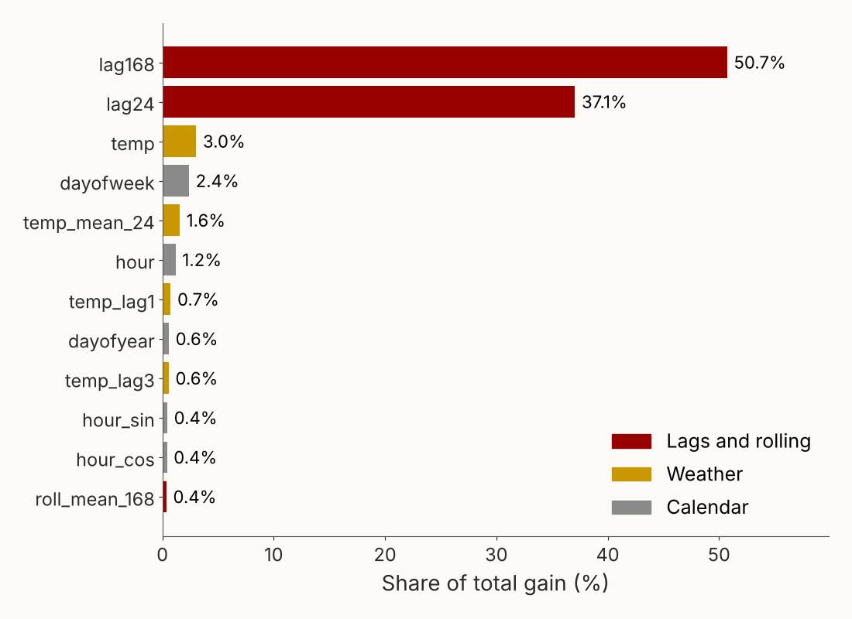
Which features does LightGBM actually use?
Reading the chart. “Gain” is how much each feature reduced the training error, summed over all the splits that used it.
The weekly and daily lags carry 88% of the gain: they set the usual shape of the day.
Weather features are small in gain, yet removing them doubles the error (next slide). They explain the difference from the usual day.
Practitioner cautions
Correlated features split the credit (temp, temp_lag1 and HDD share it).
Importance is not causation.
For a robust ranking, use permutation importance or SHAP values.
DSO 522 · ML and Deep Learning for Forecasting
Notes:
Key teaching point: gain importance and business value are different. Weather has small gain because most hours look like last week; but on the days that matter, when the weather changes, it carries the forecast. The ablation on the next slide proves it.

Slide 21
What each feature group is worth: drop it and measure
LightGBM trained with | MAE (MW) | MAPE (%)
All 20 features | 66 | 2.00
No lags or rolling windows | 85 | 2.65
No weather features | 132 | 4.13
Seasonal naive (same hour yesterday) | 157 | 4.76
Dropping weather doubles the error. Lags describe a normal day; weather tells the model how tomorrow is different. This test, called an ablation, is the most reliable way to judge a feature group: retrain without it and compare on the same validation days.
DSO 522 · ML and Deep Learning for Forecasting · results from the notebook, 14 test days
Notes:
Compare with the importance chart: lags have 88% of the gain, yet removing them costs less than removing weather. Gain measures how often a feature is useful in training; ablation measures what you lose without it. For decisions, trust the ablation.

Slide 22
Key Python functions for feature engineering
Function | What it does | Example from the notebook
pd.read_csv(…, parse_dates=[…]) | Reads data and turns text into time stamps | parse_dates=["timestamp"]
Series.dt.hour, .dt.dayofweek, .dt.month | Calendar parts of a time stamp | X["ds"].dt.hour
Series.shift(k) | The value k rows earlier: a lag | X["y"].shift(168)
Series.rolling(w).mean() / .std() | Summary of the last w rows | X["y"].shift(24).rolling(24).mean()
Series.ewm(span=w).mean() | Weighted mean, recent rows count more | X["y"].shift(24).ewm(span=24).mean()
Series.diff(k) | Change from k rows earlier | X["y"].diff(168)
Series.clip(lower=0) | Floors values at zero | (65 - X["temp"]).clip(lower=0)
np.sin(), np.cos() | Cyclical encoding | np.sin(2 * np.pi * X["hour"] / 24)
USFederalHolidayCalendar().holidays() | Dates of US federal holidays | ….holidays(start=…, end=…)
DataFrame.resample("D").mean() | Hourly to daily aggregation | X.set_index("ds")["temp"].resample("D").mean()
DataFrame.dropna() | Drops rows with missing values | Removes the first week, which has no lag168
Tip: after building features, print one row and check each value by hand against the raw data. It catches most shift and leakage bugs in a minute.
DSO 522 · ML and Deep Learning for Forecasting
Notes:
These eleven pandas functions build the entire feature table in the notebook, Section 3. Students already used most of them in the dates and times review notebook.

Slide 23
A decision tree: twenty questions for a forecast
TREE ENSEMBLES
An illustrative path through one tree
How a tree learns. It searches every feature and every threshold for the yes/no question that best separates high-load hours from low-load hours. Then it repeats inside each branch.
Why trees suit forecasting
They capture curves and thresholds, such as the U-shape in temperature, with no formula.
They find interactions automatically: temperature matters differently by hour.
No scaling or encoding of features needed.
Their weakness. One deep tree memorizes noise and gives jumpy forecasts. The fix is to combine many trees: the two ensembles on the next slides.
Is lag168 above 3,800 MW? Yes
Is the temperature above 80°F? Yes
Is the hour between 14 and 19? Yes
Forecast = average load of all training hours that took this path
DSO 522 · ML and Deep Learning for Forecasting
Notes:
The path on the left is illustrative, not taken from our fitted model. The leaf value is an average of training values, which is exactly why trees cannot predict beyond the range they have seen: they can only average what already happened.

Slide 24
Random forest: ask 500 analysts and average
How it works
Draw a random sample of rows (with replacement) from the training data.
Grow a deep tree on it, but at each split look only at a random subset of features.
Repeat hundreds of times; the forecast is the average of all trees.
Each tree is noisy in its own way. Averaging cancels the noise, the same reason a panel of analysts beats any single one.
Our result: MAE 102 MW (3.12%) in 27 seconds. Better than the naive forecast, worse than LightGBM.
Settings that matter (scikit-learn)
n_estimators: number of trees; 300–500 is plenty, more only costs time
min_samples_leaf: smallest group a leaf may average; 5–20 smooths forecasts
max_features: features tried per split; lower values make trees more different
n_jobs=-1: use every processor core
When to choose it: a robust, hard-to-break first model that needs almost no tuning. It averages away peaks, so it tends to under-forecast extremes.
DSO 522 · ML and Deep Learning for Forecasting
Notes:
Random forests are the safe choice: they rarely overfit badly. But for peak-sensitive problems like electricity, the averaging pulls forecasts toward the middle, which shows up as higher error on peak hours.

Slide 25
Gradient boosting: each tree fixes the last one’s mistakes
How it works
Start with a simple forecast: the average load.
Compute the errors (residuals) of the current forecast.
Fit a small tree that predicts those errors.
Add a fraction of that tree to the forecast (the learning rate).
Repeat hundreds of times.
Analogy: a relay team where each runner makes up for the ground the previous runner lost. Random forest averages independent trees; boosting builds them in sequence.
Why LightGBM is the industry workhorse
Very fast: bins feature values into histograms and grows the most useful leaf first.
Handles missing values and categorical features natively.
Choice of loss: squared error, absolute error, or quantile for P10/P90 ranges.
Top M5 competition solutions were built on it.
Our result: MAE 66 MW (2.00%) in under one second, the best model of the day. XGBoost and CatBoost are close cousins with similar accuracy.
DSO 522 · ML and Deep Learning for Forecasting
Notes:
A small learning rate with many trees usually beats a large rate with few trees, at the cost of time. Mention that boosting can overfit if allowed too many trees without validation; early stopping on a time-based validation set fixes that.

Slide 26
Tuning LightGBM: the settings that matter
Parameter | What it controls | Start at | Practical tip
n_estimators | Number of trees | 500 | Use more with a smaller learning rate, plus early stopping
learning_rate | How much each tree corrects | 0.05 | 0.01–0.1; smaller is more accurate but slower
num_leaves | Complexity of each tree | 31 | Main overfitting knob; try 15–127
min_child_samples | Fewest rows allowed in a leaf | 20 | Raise for noisy data to smooth forecasts
colsample_bytree | Share of features per tree | 0.8 | Adds randomness that reduces overfitting
subsample, subsample_freq | Share of rows per tree | 0.8, 1 | Needs subsample_freq=1 to take effect
objective | Loss being minimized | "l2" | "l1" targets MAE; "quantile" with alpha=0.9 gives a P90 forecast
How experienced forecasters tune: tune on rolling-origin validation windows, never on the test set. Change num_leaves and learning_rate first; they move accuracy most. Stop when gains are smaller than the noise between validation windows. Defaults are often within a few percent of the best.
DSO 522 · ML and Deep Learning for Forecasting
Notes:
Our notebook uses n_estimators 500, learning_rate 0.05, num_leaves 31 and no tuning at all, and it already wins. That is typical: feature engineering beats hyperparameter tuning. For automated search, Optuna works with both LightGBM and mlforecast.

Slide 27
Key functions: LightGBM and random forest
The same three steps for every scikit-learn-style model: create the model with its settings, .fit(X, y) on training rows, .predict(X) on new rows.
train[features]: the feature table, one row per hour
train["y"]: the load to learn
booster_.feature_importance("gain"): importance by gain; "split" counts uses
objective="quantile": forecasts a percentile, not the mean
random_state: fixes the randomness so results repeat
Tip: keep the list of feature names in one variable, so training and forecasting always use the same columns in the same order.
import lightgbm as lgb
from sklearn.ensemble import RandomForestRegressor
# 1. create, 2. fit on training rows, 3. predict
lgbm = lgb.LGBMRegressor(n_estimators=500,
learning_rate=0.05, num_leaves=31, verbosity=-1)
lgbm.fit(train[features], train["y"])
pred = lgbm.predict(test[features])
# which features did it use?
gain = lgbm.booster_.feature_importance("gain")
# a P90 forecast for peak planning
p90 = lgb.LGBMRegressor(objective="quantile", alpha=0.9)
rf = RandomForestRegressor(n_estimators=300,
min_samples_leaf=5, n_jobs=-1, random_state=1)
rf.fit(train[features], train["y"])
DSO 522 · ML and Deep Learning for Forecasting
Notes:
Notebook sections 5 and 6. Students who know scikit-learn from other courses will recognize create, fit, predict. The quantile objective is worth a minute: grid operators plan reserves on the P90 or P95 load, not the average.

Slide 28
Key functions: mlforecast, the production way
What mlforecast automates: lags, rolling windows and calendar features are built for you, correctly shifted, for one series or thousands.
Data format: columns unique_id, ds, y, plus extra inputs such as temp
static_features=[]: every extra column changes over time, so it is a known future input
X_df: tomorrow’s values of those inputs, such as the weather forecast
fit(…, max_horizon=24): switches from recursive to direct models
Our result: MAE 79 MW. Close to the hand-built 66, which has more weather features. Same algorithm, different features.
from mlforecast import MLForecast
from mlforecast.lag_transforms import RollingMean
mlf = MLForecast(
models={"LightGBM": lgb.LGBMRegressor(verbosity=-1)},
freq="h",
lags=[24, 48, 168],
lag_transforms={24: [RollingMean(window_size=24)]},
date_features=["hour", "dayofweek", "month"])
# backtest: 14 day-ahead forecasts, refit daily
cv = mlf.cross_validation(df=nixtla_df, h=24,
n_windows=14, step_size=24, static_features=[])
# production: fit, then forecast tomorrow
mlf.fit(nixtla_df, static_features=[])
fcst = mlf.predict(h=24, X_df=tomorrow_weather)
DSO 522 · ML and Deep Learning for Forecasting
Notes:
Notebook section 7.2. The hand-built version is best for learning and full control; mlforecast is best when you forecast many series or must rerun daily. The 13-point gap mostly comes from the extra weather features in the hand-built table, not from the library.

Slide 29
Neural networks in one picture, and when they pay off
DEEP LEARNING
The idea. A neural network is layers of simple units. Each unit takes a weighted sum of its inputs and bends it with a simple curve. Stack enough layers and the network can represent almost any pattern.
When deep learning pays off
Many related series trained together (thousands of products or meters): a “global” model learns shared patterns.
Long histories and long horizons.
Complex patterns that are hard to engineer by hand.
When it does not: one short series, little data, or no GPU and no time to tune.
Our result: N-HiTS with temperature, MAE 94 MW (2.83%), 38 seconds on a laptop CPU. Good, but our engineered LightGBM still wins on this single series.
Training means showing the network thousands of windows of history, comparing its forecast with what happened, and nudging every weight to reduce the error. One pass over the data is an epoch; one nudge is a step.
Deep learning models read raw history, often the last week of hours, and learn their own features instead of relying on the lags we built.
DSO 522 · ML and Deep Learning for Forecasting
Notes:
An honest message for business students: in industry, deep learning wins mostly at scale, such as Amazon forecasting millions of products. For one utility's load, a well-engineered gradient boosting model is usually as good or better, and much cheaper to run and explain.

Slide 30
LSTM: reading the series with a memory
How it works. A long short-term memory network (LSTM) reads the history one hour at a time, like reading a sentence word by word. It carries a running memory, and learned “gates” decide what to keep, what to forget and what to output.
Strengths
The classic deep learning forecaster (introduced in 1997); widely used and understood
Handles sequences of any length
Weaknesses
Reads one step at a time, so training is slow
Struggles with very long patterns, such as a weekly cycle in hourly data (168 steps back)
Often beaten by newer designs such as N-HiTS and transformers
In Python: neuralforecast.models.LSTM, same interface as N-HiTS.
Analogy: reading a story while keeping notes on the plot. You forget minor details but remember that the hero lives in Chicago, because it matters later.
In forecasting terms: it can remember that yesterday was unusually hot, or that this week started with a holiday.
DSO 522 · ML and Deep Learning for Forecasting
Notes:
Students hear "LSTM" in job postings, so it deserves a slide, but the practical recommendation for forecasting today is to start with N-HiTS or LightGBM. The LSTM was designed for language; forecasting-specific designs came later.

Slide 31
N-BEATS and N-HiTS: a decomposition the network learns
Stacks pass the leftover to the next stack
N-BEATS (2019) is a stack of simple fully connected blocks. Each block forecasts part of the series and passes what it could not explain to the next block, like the trend, seasonal and remainder steps of a decomposition.
N-HiTS (2022) adds multi-rate sampling: each stack looks at the history at a different resolution, so one stack specializes in the weekly level and another in hourly wiggles. It is faster and more accurate for long horizons.
Key facts
Outputs all 24 hours at once (multi-output)
Reads a fixed window: input_size=168 (one week)
Can use known future inputs such as temperature
Stack 1: coarse view, the slow level and trend
Stack 2: medium view, the daily shape
Stack 3: fine view, hour-to-hour detail
Forecast = sum of the three stacks’ outputs
DSO 522 · ML and Deep Learning for Forecasting
Notes:
Connect to the decomposition lectures: classical decomposition and MSTL split a series into trend, daily and weekly parts with fixed rules. N-HiTS learns a similar split from data. Adding temperature improved N-HiTS from 101 to 94 MW in our tests.

Slide 32
Temporal Fusion Transformer: a spotlight on what matters
Attention, the idea behind ChatGPT, lets a model decide which parts of its input to focus on for each prediction. For tomorrow at 5 pm, it may focus on 5 pm yesterday, 5 pm last week and tomorrow’s temperature.
The Temporal Fusion Transformer (TFT), from Google researchers, combines attention with three kinds of inputs:
Static: facts about the series (region, customer type)
Known future: calendar, holidays, weather forecast
Observed past: load and anything measured so far
Strengths
Built for many inputs of different kinds
Shows which inputs and which past hours it relied on: rare interpretability for deep learning
Produces quantile forecasts (P10, P50, P90)
Weaknesses
Heavy: needs a GPU and patience to train and tune
Overkill for a single series with one driver
In Python: neuralforecast.models.TFT, same interface as N-HiTS.
DSO 522 · ML and Deep Learning for Forecasting
Notes:
We do not run TFT in class because it takes too long on a CPU. It is the deep learning model to try when there are many series, many drivers and a need to explain which drivers mattered, for example a retailer with prices, promotions and weather.

Slide 33
Key functions: neuralforecast
Parameters to know
h: forecast horizon, 24 hours
input_size: how much history each window shows the network (168 = one week)
max_steps: training budget; raise it on a GPU
scaler_type: rescales each window so training is stable
futr_exog_list: inputs known in the future (temperature forecast, holidays)
hist_exog_list: inputs known only up to now
random_seed: makes results repeatable
Tips: switch Colab to a GPU runtime; swap NHITS for LSTM or TFT without changing anything else; average two or three seeds for stable results.
from neuralforecast import NeuralForecast
from neuralforecast.models import NHITS
nhits = NHITS(h=24, input_size=168,
max_steps=300, scaler_type="robust",
futr_exog_list=["temp"], random_seed=1)
nf = NeuralForecast(models=[nhits], freq="h")
# backtest on the same 14 days
cv = nf.cross_validation(df=data,
n_windows=14, step_size=24)
# production
nf.fit(df=data)
fcst = nf.predict(futr_df=tomorrow_weather)
DSO 522 · ML and Deep Learning for Forecasting
Notes:
Notebook section 8. The interface mirrors mlforecast: same data format, same cross_validation call. Note that neuralforecast's cross_validation trains once and then slides forward through the 14 windows, unlike mlforecast, which refits each day.

Slide 34
Foundation models: ChatGPT for numbers
FOUNDATION MODELS
The idea. Train one large model on a huge, diverse collection of time series: energy, sales, traffic, weather. It learns what trends, cycles and noise look like in general. Then it forecasts a series it has never seen, with no training: “zero-shot”.
Strengths
A strong baseline in minutes: no features, no training
Forecast ranges (quantiles) built in
Works for new products or meters with short histories
Limitations
Most versions use only the series’ own history, so they cannot use the temperature forecast. Newer releases are adding inputs like this.
Large models want a GPU
Paid APIs send your data to a vendor: check policy
How Chronos does it: it scales the series, cuts values into bins that act like words, and uses a language-model architecture to predict the next “words”. Sampling many continuations gives a forecast range.
The main models: Chronos and Chronos-Bolt (Amazon), TimesFM (Google), Moirai (Salesforce), TimeGPT (Nixtla, paid API).
DSO 522 · ML and Deep Learning for Forecasting
Notes:
This field is moving fast. The practical stance: use a foundation model as a quick, strong benchmark on day one. If your engineered model cannot beat it, your features need work. For weather-driven load, expect the engineered LightGBM to win because it uses the temperature forecast.

Slide 35
Key functions: Chronos in a few lines
What each piece does
from_pretrained: loads a model by name; “small” runs on a CPU, bigger ones want a GPU (device_map="cuda")
context: the recent history; Chronos-Bolt reads up to 2,048 values (about 12 weeks of hours)
prediction_length: the horizon
quantile_levels: the percentiles you want; P10 to P90 gives an 80% range
No fit step. That is the point of a zero-shot model.
Tip: run it in Colab (it needs internet to download the model) and add its 14-day score to the bake-off table.
import torch
from chronos import BaseChronosPipeline
# downloads the pretrained model once
pipe = BaseChronosPipeline.from_pretrained(
"amazon/chronos-bolt-small", device_map="cuda")
history = df[df["ds"] < day]["y"].tail(2048)
quantiles, mean = pipe.predict_quantiles(
context=torch.tensor(history.values,
dtype=torch.float32),
prediction_length=24,
quantile_levels=[0.1, 0.5, 0.9])
median = quantiles[0, :, 1] # P50 forecast
DSO 522 · ML and Deep Learning for Forecasting
Notes:
Notebook section 9 loops this over the 14 test days. The output array has shape [series, horizon, quantiles], so quantiles[0, :, 1] is the median for our one series. The cell is left for students to run in Colab, where it downloads the model from Hugging Face.

Slide 36
Four accuracy metrics and when to use each
EVALUATION
MAE: mean absolute error
RMSE: root mean squared error
mean(|actual − forecast|)
sqrt(mean((actual − forecast)²))
The typical miss in the units of the series (MW). Easy to explain to managers and easy to convert to dollars. Our headline metric.
Squares the misses, so big misses count much more. Use it when one large error is costlier than many small ones, as in peak hours.
MAPE: mean absolute % error
MASE: mean absolute scaled error
mean(|actual − forecast| / actual) × 100
MAE(model) / MAE(seasonal naive)
Unit-free, so you can compare series of different sizes. Breaks down when actuals are near zero (intermittent sales) and penalizes over-forecasts more.
Below 1 means you beat the naive forecast. Our LightGBM: 66 / 157 ≈ 0.42, so it removes 58% of the naive error.
DSO 522 · ML and Deep Learning for Forecasting
Notes:
Practitioner rule: always report a naive benchmark next to your model. Here MASE is computed against the same-hour-yesterday naive on the test days; textbook MASE scales by the in-sample naive error, but the idea is the same. Pick the metric that matches the business cost before you start modeling, not after.

Slide 37
Key functions: statsforecast benchmarks and scoring
What each piece does
SeasonalNaive(24): tomorrow = today, hour by hour. The bar every model must clear.
MSTL: removes the daily (24) and weekly (168) cycles, forecasts the rest with ETS, then adds the cycles back.
cross_validation: the rolling-origin backtest: 14 windows of 24 hours, one day apart.
evaluate: scores every model column in one table.
Tips: the data must have columns unique_id, ds, y (same as mlforecast and neuralforecast). Use n_jobs=-1 to use all CPU cores. MSTL here scored 126 MW in 11 seconds: a strong classical benchmark, but it cannot use temperature.
from statsforecast import StatsForecast
from statsforecast.models import (SeasonalNaive,
MSTL, AutoETS)
sf = StatsForecast(models=[
SeasonalNaive(season_length=24),
MSTL(season_length=[24, 168],
trend_forecaster=AutoETS(model="ZZN"))],
freq="h", n_jobs=-1)
cv = sf.cross_validation(df=data[["unique_id","ds","y"]],
h=24, n_windows=14, step_size=24)
from utilsforecast.evaluation import evaluate
from utilsforecast.losses import mae, rmse, mape
evaluate(cv.drop(columns="cutoff"),
metrics=[mae, rmse, mape])
DSO 522 · ML and Deep Learning for Forecasting
Notes:
Notebook section 6. The three Nixtla libraries (statsforecast, mlforecast, neuralforecast) share the same data format and the same cross_validation output, so you can stack their results into one bake-off table with a simple merge on unique_id, ds and cutoff.

Slide 38
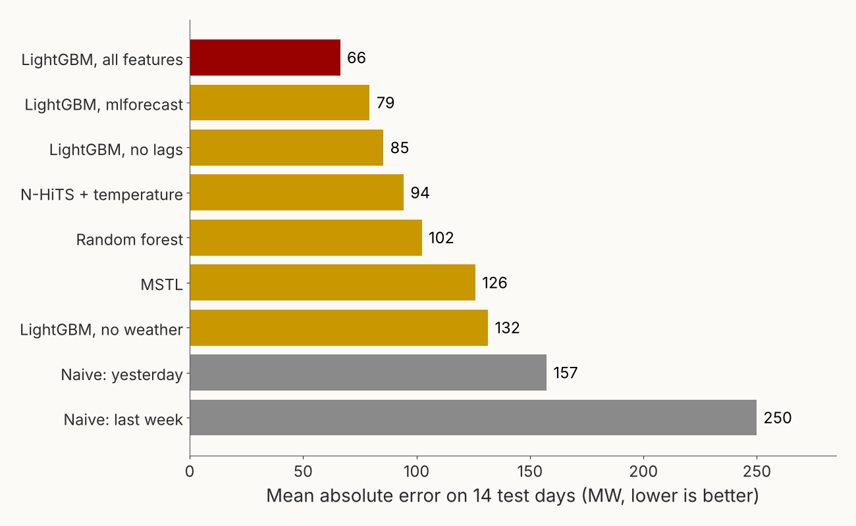
The bake-off: same 14 days, every model
MAE in MW (MAPE), training time
LightGBM, all features: 66 (2.0%), 1 s
LightGBM via mlforecast, retrained daily: 79 (2.4%), 14 s
N-HiTS with temperature: 94 (2.8%), 38 s
Random forest: 102 (3.1%), 26 s
MSTL: 126 (3.9%), 11 s
Naive, same hour yesterday: 157 (4.8%)
Lessons
Features beat algorithms: LightGBM without weather (132) loses to every model that sees temperature.
The fastest model won. Complexity must earn its place.
Differences of a few MW across 14 days are noise; test on more days before deciding.
DSO 522 · ML and Deep Learning for Forecasting
Notes:
All numbers come from the notebook run on the last 14 days of 2014. The mlforecast version is slightly worse than the hand-built LightGBM because it uses fewer engineered features and refits each day. Ask students: which model would you put into production, and why? Accuracy, speed, simplicity and explainability all point to LightGBM here.

Slide 39
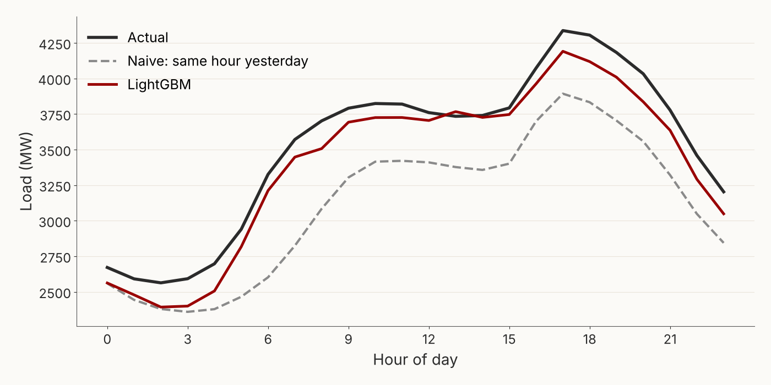
Where the model earns its keep: a weather-swing day
December 29, 2014: the largest day-over-day temperature change in the test period. It got much colder than the day before.
Naive copies yesterday’s milder day and misses by 409 MW on average.
LightGBM sees the colder forecast through temp, HDD and temp_mean_24 and misses by 127 MW.
Practitioner lesson: average accuracy hides the days that matter. Always look at your worst days and at days when conditions change.
Note the remaining gap: LightGBM still under-forecasts the evening peak. Trees cannot predict above loads they have seen in similar conditions, so cold snaps beyond the training range need extra care (more cold history, a linear term for HDD, or a residual model).
DSO 522 · ML and Deep Learning for Forecasting
Notes:
This is the slide that sells machine learning to a manager. On ordinary days everybody is close. On days when the weather swings, the naive approach fails badly and the model with weather features does not. Those are the days when power is most expensive.

Slide 40
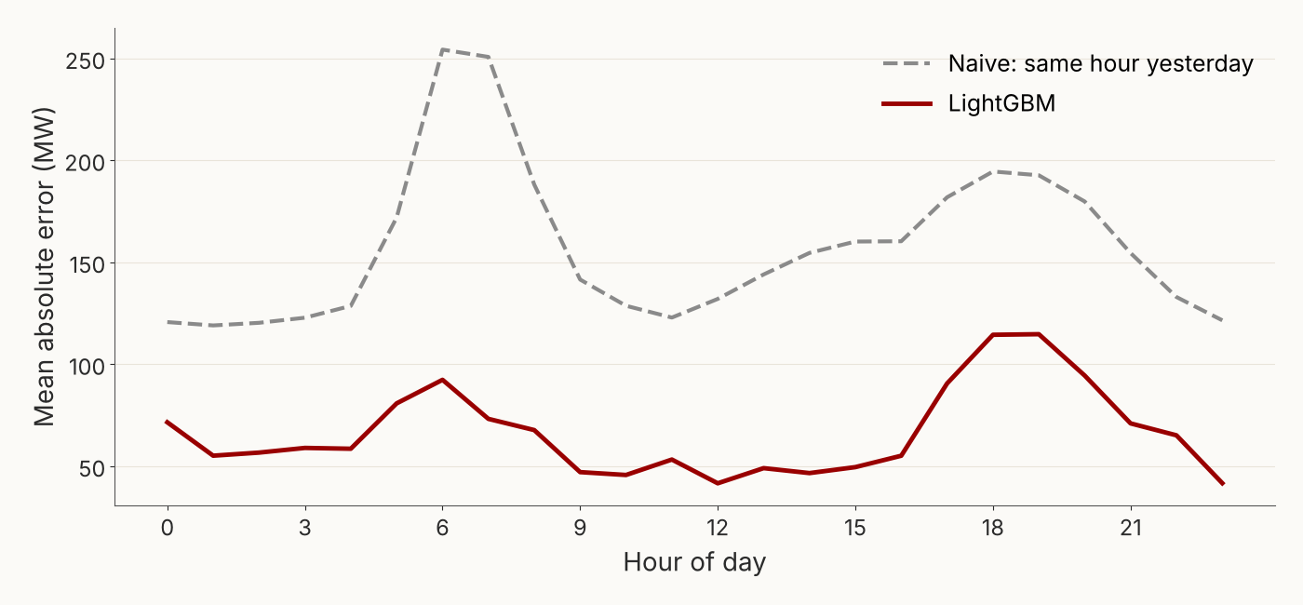
Error by hour of day: where to improve next
What the chart shows
Naive errors spike at the morning ramp (6–7 am) and the evening peak: the hours when load changes fastest.
LightGBM flattens the morning spike but still has its largest errors at 5–8 pm, up to about 115 MW.
Why the evening is hard: winter peaks depend on sunset, lighting and how cold the evening gets, and errors there are the most expensive because peak power costs the most.
Next steps a practitioner would try: a peak-hour flag, hourly temperature forecasts for the evening, daylight hours, or a separate model for peak hours.
DSO 522 · ML and Deep Learning for Forecasting
Notes:
Error analysis by segment (hour, day of week, temperature band, holiday) is how practitioners decide which feature to build next. One line in pandas: test.groupby("hour")["abs_err"].mean().

Slide 41
Translate accuracy into dollars
91 MW less error per hour
Where the $20 comes from. It is an illustrative assumption for the cost of each MWh of forecast error: buying last-minute power when you under-forecast, or paying for unused generation when you over-forecast. Real costs vary by market, season and hour, and peak-hour errors cost far more.
How a practitioner uses this
Ask finance for the real cost of under- and over-forecasting; they are rarely equal.
Compare the saving with the cost of building and running the model.
Present the dollar figure first, the MAE second.
× 8,760 hours in a year
× $20 per MWh of error
≈ $15.9 million
per year, LightGBM versus the naive forecast
DSO 522 · ML and Deep Learning for Forecasting
Notes:
Notebook final section computes this with cost_per_mwh_of_error = 20. Have students change the number and see how the business case moves. If under-forecasting costs more than over-forecasting, a quantile forecast above the median may be the better business choice.

Slide 42
Which model when: a practitioner’s guide
Your situation | Start with | Why
Any new project, day one | Seasonal naive + MSTL or ETS | Sets the bar in minutes; every later model must beat it
Strong drivers (weather, price, promotions, holidays) | LightGBM with engineered features | Uses drivers directly; fast, accurate, explainable with importance and SHAP
Hundreds to millions of related series | Global LightGBM (mlforecast) or N-HiTS | One model learns shared patterns across series
Long histories, long horizons, a GPU | N-HiTS, then TFT | Learn their own features; TFT handles many input types
New product or short history | Foundation model (Chronos, TimesFM) | Zero-shot: needs no training on your data
Need forecast ranges for risk decisions | Quantile LightGBM, Chronos, TFT | Give P10/P50/P90 instead of a single number
Few drivers, small data, must explain every number | Regression or ETS/ARIMA | Transparent coefficients; ML adds little
Rule of thumb: the best final answer is often an average of two different good models (for example LightGBM and N-HiTS). Ensembles cancel out each model’s particular mistakes.
DSO 522 · ML and Deep Learning for Forecasting
Notes:
Walk through two or three rows with examples students know: a utility (row 2), Amazon or Walmart (row 3), a new iPhone launch (row 5). Note that the M5 forecasting competition on Walmart data was won by LightGBM models with careful features.

Slide 43
Twelve lessons from forecasting in production
Beat naive first. If you cannot, stop and find out why.
Ask “would I know this at forecast time?” for every feature. Leakage is the most common reason a great backtest fails in production.
Validate the way you will forecast: rolling origin, same horizon, same data delays.
Train on actual weather, run on forecast weather. Expect production error to be higher than the backtest; test with archived forecasts if you have them.
Features beat algorithms. A week on features usually helps more than a week on tuning.
Look at the worst days, not just the average.
Holidays and special events cause the biggest misses. Keep a calendar and update it.
Retrain on a schedule (weekly or monthly) and monitor error every day; alert when it drifts.
Keep the naive model running as a fallback when data feeds break.
Fix random seeds and log versions so results can be reproduced.
Report ranges, not just one number, when decisions depend on risk.
Speak in dollars. Managers fund savings, not lower MAPE.
DSO 522 · ML and Deep Learning for Forecasting
Notes:
Lesson 4 matters for this case: our temperature features use actual temperature, which in production would be a forecast. Day-ahead temperature forecasts usually miss by a degree or two, which adds error. That is why utilities buy weather forecasts from several vendors and blend them.

Slide 44
Summary and what to do next
Five ideas to remember
Your next steps
Machine learning forecasts by turning time into a table of features.
Only use what you would know at forecast time.
Test with a rolling-origin backtest against a naive benchmark.
LightGBM with good features is the practical default; deep learning and foundation models shine at scale.
Judge models in business terms: worst days and dollars.
Open the notebook in Colab and run it top to bottom.
Run the Chronos cell and add its score to the bake-off.
Add one new feature, rerun, and check whether MAE drops.
Apply the same workflow to the class forecasting competition.
Libraries used
pandas · lightgbm · scikit-learn · statsforecast · mlforecast · neuralforecast · chronos-forecasting · utilsforecast
DSO 522 · ML and Deep Learning for Forecasting
Notes:
Close by returning to the opening question: which model is best? The answer is the one that beats naive on honest validation, uses information available at forecast time, and saves the most money for what it costs to run. Today that was LightGBM with weather features.

